Slide 1
Features Of Uterine Cancer Sample
Jonathan Feige
Catherine Baugher
Dr. Welch
Dr. Elnitski

Slide 2
Research questions
Question 1: What are the interesting mutations?
Question 2:
What relationships exist among the mutations?

Slide 3
Question 1
What are the interesting mutations?
RPL22, DOCK3, HAS2, RNF43, CSNK1G1, among others as well.
These are all considering cimp+
I believe we have found 80 – 90% of all interesting cimp+ mutations.
We have done minimal exploration in Non-Cimp+
This includes PPP21RA, PIK3CA, and many others.
I believe we have found 20 – 30% of all interesting Non-cimp+ mutations.

Slide 4
Question 2
What relationships exist among the mutations?
We have investigated the correlation of mutations in the dataset
In the future we will look at the biological relationships to help draw better conclusions.
I believe we are 50% through researching cimp+ relationships.
I believe we are 10% through researching Non-cimp+ relationships.

Slide 5
Project Overview
Reviewing the statistical features for the Uterine cancer type
The samples came from the TCGA Pan Cancer Atlas
Uterine Carcinosarcoma
https://www.cbioportal.org/study/summary?id=ucs_tcga_pan_can_atlas_2018
Uterine Corpus Endometrial Carcinoma
https://www.cbioportal.org/study/summary?id=ucec_tcga_pan_can_atlas_2018
108 Cimp+ samples
271 Non-Cimp+ samples
There are 8086 total Mutations

Slide 6
Data Flowchart
Filtered Data TP > 5 FP < Max P > 0.05
Top 40 Correlation Bottom 10 Correlation Correlation Heatmaps Network Diagrams Violin Plot Box Plot
6 – 9 11 18 – 21 10, 19 – 21 15 16 Slides
Uterine Data
Unfiltered Data
Greedy Selection Positive Negative Set cover Decision Tree Feature Matrix
13 14 5 4 Slides

Slide 7
Correlation Flowchart
TP Filter TP > 9
53 Features
Uterine Data
General Filter TP > 5 FP < Max P > 0.05
TP - FP Filter TP - FP > 7
Filter Feature Total = 112 37 Repeat features
8000 Features
35 Features
FP = 0 Filter FP = 0 TP > 6
Union
24 Features
Filter Feature Total = 75
300 Total Features

Slide 8
Cluster 1 Size: 58
Uterine Data
Filtered Data TP > 5 FP < Max P > 0.05
K-means Clustering (Cimp+ only)
Cluster 2 Size: 15
Cluster 3 Size: 35

Slide 9
Fisher's Exact (P Value) | Accuracy (TP + TN/ TP + TN + FP + FN) | Info Gain | F-Measure (1/ (Sen + Spec)/2) | CART Phi | Sensitivity (TP / TP+FN) | Specificity (TN / TN + FP) | Greedy Selection (TP) | Positive Negative partial set cover – Mutation level (TP – FP) | Positive Negative Partial set cover – Gene Level (TP – FP) | Positive Negative Set Cover – Mutation level / Weighted (Cimp+ - Cimp-) | Decision Tree | Random Forest (avg gini across folds)
RPL22 3.86 E-9 | RPL22 0.759 | RPL22 0.251 | RPL22 0.372 | RPL22 0.173 | RPL22 0.25 | PCDH9 1 | RPL22 27 | RPL22 17 | RPL22 17 | RPL22 26 | RPL22 0.033 | RPL22 0.036
DOCK3 1.34 E-7 | DOCK3 0.751 | DOCK3 0.238 | DOCK3 0.318 | DOCK3 0.141 | DOCK3 0.203 | HAS2 1 | KRAS 16 | DOCK3 9 | HAS2 11 | DOCK3 14 | DOCK3 0.024 | DOCK3 0.025
DONSON 6.26 E-6 | DONSON 0.741 | PCDH9 0.228 | RNF43 0.307 | RNF43 0.126 | RNF43 0.203 | MESDC1 1 | RNF43 11 | HAS2 7 | DOCK3 7 | RNF43 7 | POF1B 0.018 | ESRP1 0.019
ESRP1 9.49 E-6 | ESRP1 0.741 | HAS2 0.228 | KRAS 0.289 | KRAS 0.099 | KRAS 0.203 | AFF1 1 | PIK3CA 10 | CTNNA2 5 | KCNH7 3 | BCOR 7 | G3BP1 0.017 | DONSON 0.016
PCDH9 9.68 E-6 | CSNK1G1 0.741 | MESDC1 0.228 | NCOA3 0.232 | NCOA3 0.095 | NCOA3 0.138 | MAGI1 1 | PTEN 7 | PIK3CA 4 | ZNF626 3 | KRAS 5 | KCNA4 0.017 | HAS2 0.014
HAS2 9.68 E-6 | CTNNA2 0.741 | DONSON 0.226 | DRD5 0.220 | DRD5 0.090 | DRD5 0.129 | CNTLN 1 | BCOR 6 | ESF1 4 | PAPD5 2 | PIK3CA 5 | MESDC1 0.017 | CSNK1G1 0.014
MESDC1 9.68 E-6 | PCDH9 0.738 | ESRP1 0.224 | CSNK1G1 0.209 | CSNK1G1 0.089 | CSNK1G1 0.120 | SIKE1 1 | PIK3CA 5 | JAK1 3 | SOX17 2 | HAS2 4 | AFF1 0.016 | RNF43 0.014
CSNK1G1 1.16 E-5 | HAS2 0.738 | AFF1 0.223 | CTNNA2 0.209 | CTNNA2 0.089 | CTNNA2 0.120 | KCNA4 1 | SOX17 3 | BLNK 2 | ZNF609 2 | SOX17 3 | HAS2 0.015 | PCDH9 0.014
CTNNA2 1.16 E-5 | MESDC1 0.738 | CSNK1G1 0.223 | ACVR2A 0.201 | ESRP1 0.084 | ACVR2A 0.120 | BTBD11 1 | NCOA3 3 | ZBTB20 2 | ADNP2 2 | PIK3CA 2 | ESRP1 0.015 | CTNNA2 0.013
RNF43 1.29 E-5 | RNF43 0.738 | CTNNA2 0.223 | PTEN 0.196 | DONSON 0.080 | PTEN 0.120 | ZMIZ1 1 | PIK3CA 2 | GPAT2 2 | ZBTB20 2 | ADNP2 2 | CTCF 0.014 | MUM1L1 0.013

Slide 10
RPL22 | 12
DOCK3 | 11
HAS2 | 9
RNF43 | 8
CSNK1G1 | 7
CTNNA2 | 7
ESRP1 | 6
PIK3CA | 6
KRAS | 5
MESDC1 | 5
PCDH9 | 5
DONSON | 4
NCOA3 | 4
AFF1 | 3
DRD5 | 3
PTEN | 3
SOX17 | 3
ACVR2A | 2
ADNP2 | 2
BCOR | 2
KCNA4 | 2
ZBTB20 | 2
BLNK | 1
BTBD11 | 1
CNTLN | 1
CTCF | 1
ESF1 | 1
G3BP1 | 1
GPAT2 | 1
JAK1 | 1
KCNH7 | 1
MAGI1 | 1
MUM1L1 | 1
PAPD5 | 1
POF1B | 1
SIKE1 | 1
ZMIZ1 | 1
ZNF609 | 1
ZNF626 | 1
Feature Count 39 Total Features. RPL22 most common at 12 occurrences. 17 Features occurring one time.

Slide 11
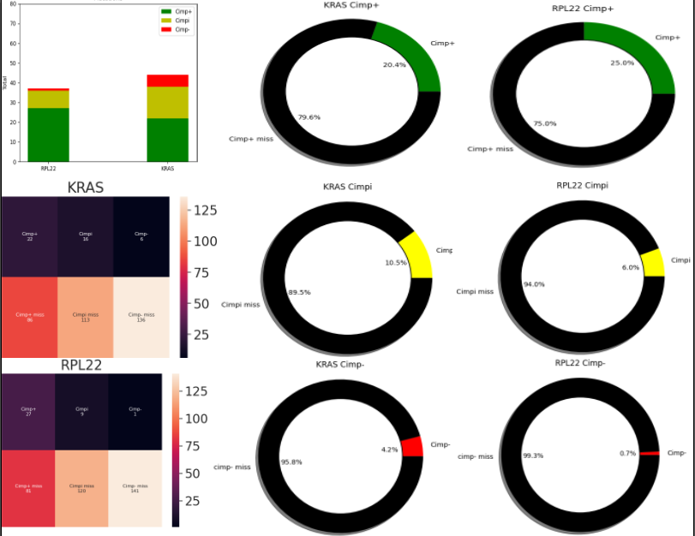

Slide 12
Mini Decision Tree Infogain
108 Cimp+ | 271 Non-Cimp+ | 379 Total Samples
RPL22 Infogain: 0.251
TP:27 FP:10
FN:81 TN:261
ROCK1P1Infogain: -0.202
HAS2 Infogain: 0.279
TP:0 FP:3
FN:27 TN:7
TP:8 FP:0
FN:73 TN:261
GOT1 Infogain: 0 TP:0 FP:0 FN:0 TN:3
PTOV1 Infogain: -0.092 TP:0 FP:3 FN:27 TN:4
GOT1 Infogain: 0 TP:0 FP:0 FN:0 TN:8
DOCK3 Infogain: 0.295 TP:13 FP:5 FN:60 TN:256

Slide 13
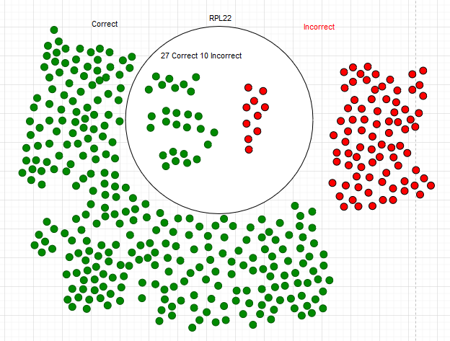
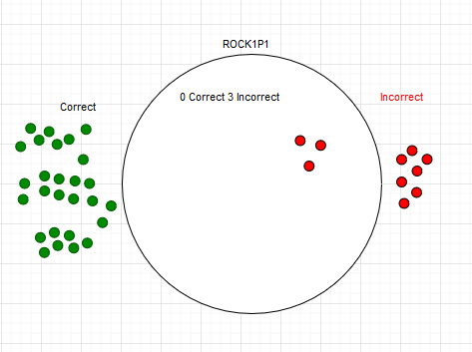
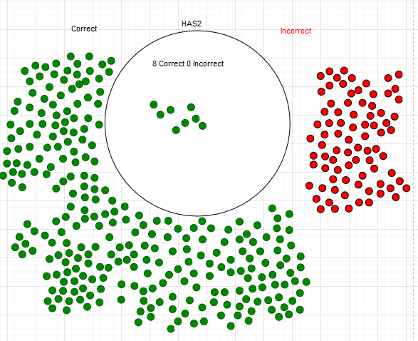
PTOV1
Infogain: -0.092
TP:0 FP:3
FN:27 TN:4
GOT1 Infogain: 0 TP:0 FP:0 FN:0 TN:3
GOT1 Infogain: 0 TP:0 FP:0 FN:0 TN:8
DOCK3 Infogain: 0.295 TP:13 FP:5 FN:60 TN:256

Slide 14
Mini Decision Tree Cart Phi
108 Cimp+ | 271 Non-Cimp+ | 379 Total Samples
RPL22 Cart Phi: 0.173
TP:27 FP:10
FN:81 TN:261
PID1 Cart Phi: 0.306
DOCK3 Cart Phi: 0.111
TP:3 FP:5
FN:24 TN:5
TP:14 FP:5
FN:67 TN: 256
C18orf25 Cart Phi: 0.937 TP:3 FP:0 FN:0 TN:5
DDX18 Cart Phi: 0.271 TP:3 FP:3 FN:21 TN:2
SMAD5 Cart Phi: 0.409 TP:1 FP:3 FN:13 TN:2
KRAS Cart Phi: 0.078 TP:13 FP:19 FN:54 TN:237

Slide 15
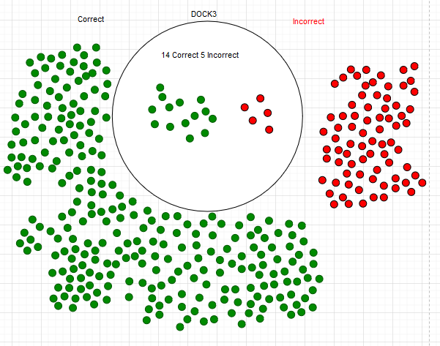
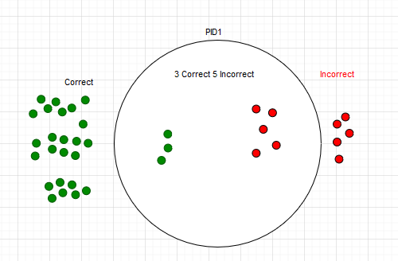
SMAD5 Cart Phi: 0.409 TP:1 FP:3 FN:13 TN:2
KRAS Cart Phi: 0.078 TP:13 FP:19 FN:54 TN:237
C18orf25 Cart Phi: 0.937 TP:3 FP:0 FN:0 TN:5
DDX18 Cart Phi: 0.271 TP:3 FP:3 FN:21 TN:2

Slide 16
Mini Decision Tree TP-FP
108 Cimp+ | 271 Non-Cimp+ | 379 Total Samples
RPL22 Value = 17
TP:27 FP:10
FN:81 TN:261
ACVR2A Value: 8
DOCK3 Value: 9
TP:9 FP:1
FN:18 TN:9
TP:14 FP:5
FN:67 TN:256
JAK1 Value: 4 TP:4 FP:0 FN:5 TN:1
GOT1 Value: 0 TP:0 FP:0 FN:18 TN:9
RNF43 Value: 6 TP:6 FP:0 FN:8 TN:5
PARD3 Value: 0 TP:0 FP:0 FN:67 TN:256

Slide 17
Feature 1 Top 20 part 1 (only cimp+) | Feature 2 | Value
DRD5_GRCh37_4:9785421-9785421_3'UTR_SNP_G-G-T | DRD5_GRCh37_4:9785349-9785349_3'UTR_SNP_G-G-C | 0.732626
ANKH_GRCh37_5:14711209-14711209_3'UTR_DEL_A-A-- | DRD5_GRCh37_4:9785349-9785349_3'UTR_SNP_G-G-C | 0.681537
DPF3_GRCh37_14:73136813-73136813_Intron_DEL_A-A-- | CLVS1_GRCh37_8:62412295-62412295_3'UTR_DEL_T-T-- | 0.563056
MAF_GRCh37_16:79630784-79630784_3'UTR_DEL_T-T-- | BCL7A_GRCh37_12:122498698-122498698_3'UTR_DEL_T-T-- | 0.554322
GRHL3_GRCh37_1:24681723-24681723_Intron_DEL_T-T-- | CTNNA2_GRCh37_2:80875615-80875615_3'UTR_DEL_T-T-- | 0.531414
DRD5_GRCh37_4:9785421-9785421_3'UTR_SNP_G-G-T | JAK1_GRCh37_1:65306997-65306997_Frame-Shift-Del_DEL_T-T-- | 0.526123
MAF_GRCh37_16:79630784-79630784_3'UTR_DEL_T-T-- | DDHD1_GRCh37_14:53513450-53513480_3'UTR_DEL_AATCAGTTTTAGGCCATTCATGTCCTTCAAG-AATCAGTTTTAGGCCATTCATGTCCTTCAAG-TCAGTTTTAGGCCATTCATGTCCTTCA | 0.519517
NFIA_GRCh37_1:61543223-61543223_5'Flank_DEL_A-A-- | BCL7A_GRCh37_12:122498698-122498698_3'UTR_DEL_T-T-- | 0.515152
DDX3X_GRCh37_X:41207100-41207100_3'UTR_DEL_T-T-- | ASB7_GRCh37_15:101189294-101189294_3'UTR_DEL_T-T-- | 0.511891
TCEAL1_GRCh37_X:102885616-102885617_3'UTR_INS_----A | FAM222A_GRCh37_12:110208200-110208200_3'UTR_DEL_T-T-- | 0.511891

Slide 18
Feature 1 Top 20 part 2 (only cimp+) | Feature 2 | Value
DENND1C_GRCh37_19:6477251-6477251_Frame-Shift-Del_DEL_G-G-- | MSH3_GRCh37_5:79970915-79970915_Frame-Shift-Del_DEL_A-A-- | 0.511891
DENND1C_GRCh37_19:6477251-6477251_Frame-Shift-Del_DEL_G-G-- | DRD5_GRCh37_4:9785349-9785349_3'UTR_SNP_G-G-C | 0.508114
NFIA_GRCh37_1:61543223-61543223_5'Flank_DEL_A-A-- | DRD5_GRCh37_4:9785349-9785349_3'UTR_SNP_G-G-C | 0.482063
PID1_GRCh37_2:229889189-229889189_3'Flank_DEL_A-A-- | DDHD1_GRCh37_14:53513450-53513480_3'UTR_DEL_AATCAGTTTTAGGCCATTCATGTCCTTCAAG-AATCAGTTTTAGGCCATTCATGTCCTTCAAG-TCAGTTTTAGGCCATTCATGTCCTTCA | 0.481571
IRX3_GRCh37_16:54317531-54317531_3'UTR_DEL_T-T-- | ZFP91_GRCh37_11:58386428-58386428_3'UTR_DEL_T-T-- | 0.481571
CHD3_GRCh37_17:7798765-7798765_Frame-Shift-Del_DEL_C-C-- | POTEG_GRCh37_14:19563232-19563232_RNA_SNP_T-T-C | 0.481571
DENND1C_GRCh37_19:6477251-6477251_Frame-Shift-Del_DEL_G-G-- | DRD5_GRCh37_4:9785421-9785421_3'UTR_SNP_G-G-T | 0.480346
DENND1C_GRCh37_19:6477251-6477251_Frame-Shift-Del_DEL_G-G-- | ABHD13_GRCh37_13:108884458-108884458_3'UTR_DEL_A-A-- | 0.470588
MAPK1_GRCh37_22:22114661-22114661_3'UTR_DEL_T-T-- | ELOVL5_GRCh37_6:53133582-53133582_3'UTR_DEL_A-A-- | 0.470588
SIKE1_GRCh37_1:115316465-115316465_3'UTR_DEL_A-A-- | ASB7_GRCh37_15:101189294-101189294_3'UTR_DEL_T-T-- | 0.46492

Slide 19
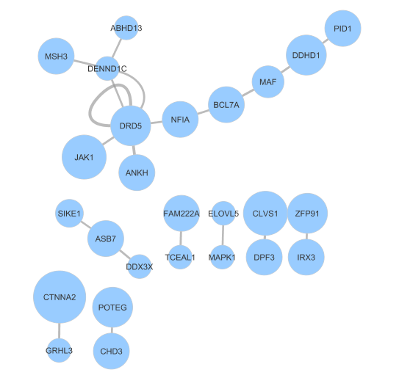
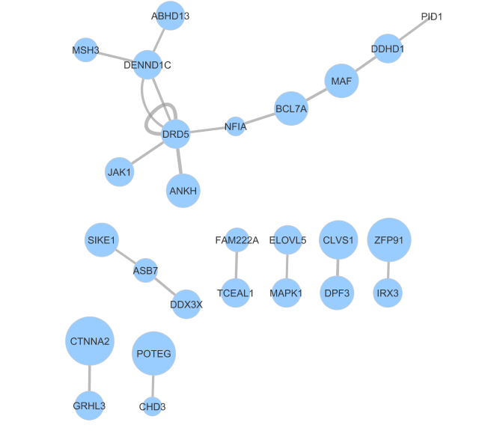
Network Diagram for top 20
TP | Pos Neg Set Cover

Slide 20
Feature 1 Bottom 10 (only cimp+) | Feature 2 | Value
CTNNA2_GRCh37_2:80875615-80875615_3'UTR_DEL_T-T-- | KRAS_GRCh37_12:25398284-25398284_Missense-Mutation_SNP_C-C-A_C-C-T_C-C-G | -0.1871
PIK3CA_GRCh37_3:178916876-178916876_Missense-Mutation_SNP_G-G-A | DOCK3_GRCh37_3:51417604-51417604_Frame-Shift-Del_DEL_C-C-- | -0.17882
PIK3CA_GRCh37_3:178916876-178916876_Missense-Mutation_SNP_G-G-A | KRAS_GRCh37_12:25398284-25398284_Missense-Mutation_SNP_C-C-A_C-C-T_C-C-G | -0.17882
INPPL1_GRCh37_11:71948748-71948748_Frame-Shift-Del_DEL_C-C-- | KRAS_GRCh37_12:25398284-25398284_Missense-Mutation_SNP_C-C-A_C-C-T_C-C-G | -0.16157
FAT1_GRCh37_4:187509412-187509412_3'UTR_DEL_A-A-- | KRAS_GRCh37_12:25398284-25398284_Missense-Mutation_SNP_C-C-A_C-C-T_C-C-G | -0.16157
UPF3A_GRCh37_13:115057211-115057211_Frame-Shift-Del_DEL_A-A-- | KRAS_GRCh37_12:25398284-25398284_Missense-Mutation_SNP_C-C-A_C-C-T_C-C-G | -0.1525
MAF_GRCh37_16:79630784-79630784_3'UTR_DEL_T-T-- | KRAS_GRCh37_12:25398284-25398284_Missense-Mutation_SNP_C-C-A_C-C-T_C-C-G | -0.14306
PTEN_GRCh37_10:89692904-89692904_Missense-Mutation_SNP_C-C-G | ACVR2A_GRCh37_2:148683686-148683686_Frame-Shift-Del_DEL_A-A-- | -0.13684
PTEN_GRCh37_10:89692904-89692904_Missense-Mutation_SNP_C-C-G | CSNK1G1_GRCh37_15:64461260-64461260_3'UTR_DEL_A-A-- | -0.13684
PIK3CA_GRCh37_3:178916876-178916876_Missense-Mutation_SNP_G-G-A | DRD5_GRCh37_4:9785349-9785349_3'UTR_SNP_G-G-C | -0.13644

Slide 21
Feature 1 Bottom 10 (only cimp+) | Feature 2 | Value
MAGI1_GRCh37_3:65340578-65340578_3'Flank_DEL_T-T-- | DOCK3_GRCh37_3:51417604-51417604_Frame-Shift-Del_DEL_C-C-- | -0.13315
SIKE1_GRCh37_1:115316465-115316465_3'UTR_DEL_A-A-- | KRAS_GRCh37_12:25398284-25398284_Missense-Mutation_SNP_C-C-A_C-C-T_C-C-G | -0.13315
PIK3CA_GRCh37_3:178916876-178916876_Missense-Mutation_SNP_G-G-A | ACVR2A_GRCh37_2:148683686-148683686_Frame-Shift-Del_DEL_A-A-- | -0.13079
PIK3CA_GRCh37_3:178916876-178916876_Missense-Mutation_SNP_G-G-A | CTNNA2_GRCh37_2:80875615-80875615_3'UTR_DEL_T-T-- | -0.13079
DRD5_GRCh37_4:9785349-9785349_3'UTR_SNP_G-G-C | KRAS_GRCh37_12:25398284-25398284_Missense-Mutation_SNP_C-C-A_C-C-T_C-C-G | -0.12675
SHC1_GRCh37_1:154935863-154935863_3'UTR_DEL_G-G-- | BCOR_GRCh37_X:39921444-39921444_Missense-Mutation_SNP_T-T-C | -0.125
BCOR_GRCh37_X:39921444-39921444_Missense-Mutation_SNP_T-T-C | SETD1B_GRCh37_12:122242658-122242658_Frame-Shift-Del_DEL_C-C-- | -0.125
JAK1_GRCh37_1:65306997-65306997_Frame-Shift-Del_DEL_T-T-- | PTEN_GRCh37_10:89692904-89692904_Missense-Mutation_SNP_C-C-G | -0.12457
DONSON_GRCh37_21:34947889-34947889_3'Flank_DEL_T-T-- | PTEN_GRCh37_10:89692904-89692904_Missense-Mutation_SNP_C-C-G | -0.12457
RSBN1L_GRCh37_7:77408706-77408706_3'UTR_DEL_A-A-- | KRAS_GRCh37_12:25398284-25398284_Missense-Mutation_SNP_C-C-A_C-C-T_C-C-G | -0.12267

Slide 22
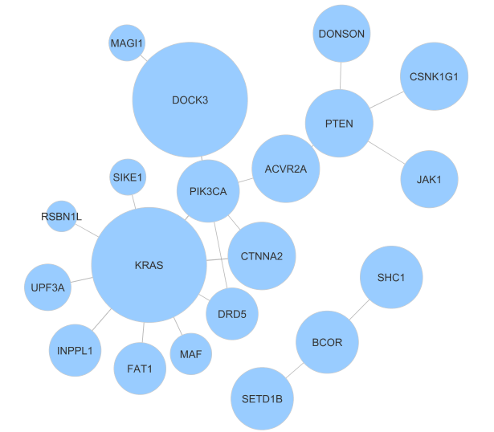
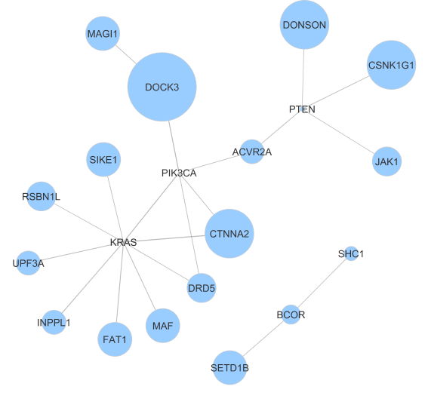
Network Diagram for 20 bottom (- Correlation)
TP | Pos Neg Set Cover

Slide 23
DRD5 Gene
DRD5 is the gene that encodes the D5 dopamine receptor.
DRD5 is a dopamine receptor family member that opposes DRD2 signaling.
DRD2 is a G protein-coupled receptor antagonized by ONC201, an anti-cancer small molecule.
Future work may include exploration of dopamine receptors of DRD5 in this cancer type.
Prabhu, V., Madhukar, N., Gilvary, C., Kline, C., Oster, S., El-Deiry, W., . . . Allen, J. (2019, April 01). Dopamine Receptor D5 is a Modulator of Tumor Response to Dopamine Receptor D2 Antagonism.
https://www.ncbi.nlm.nih.gov/pmc/articles/PMC7259201/

Slide 24
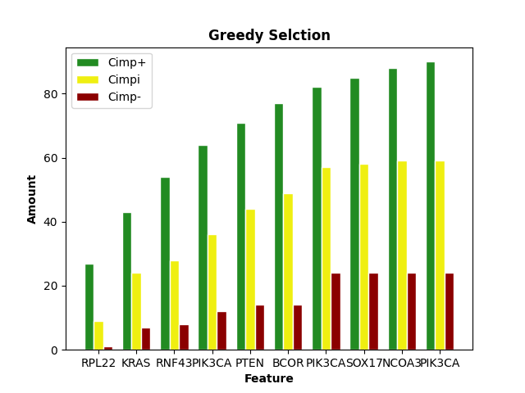
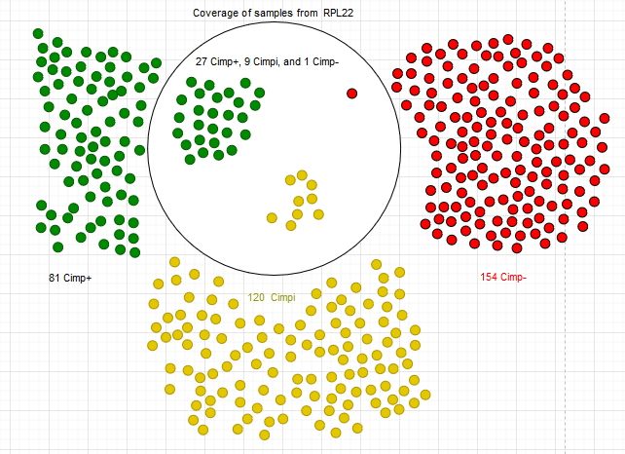
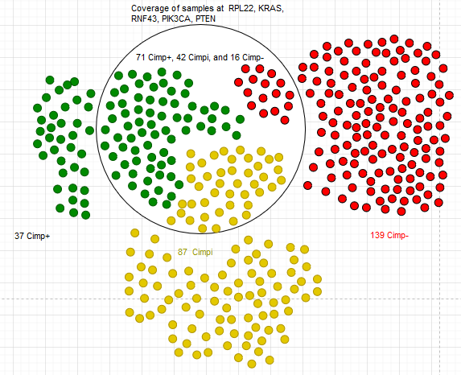
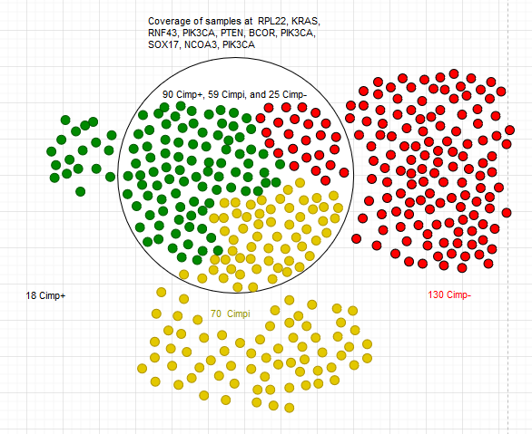

Slide 25
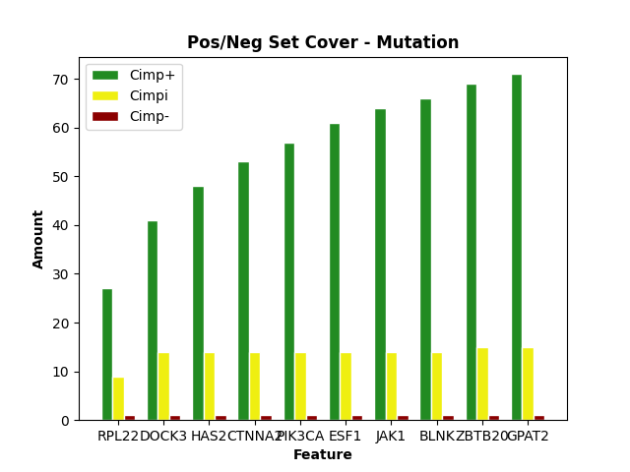
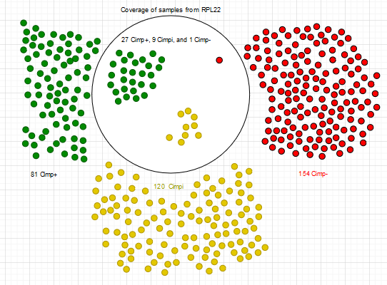
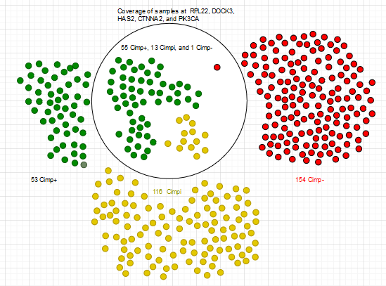
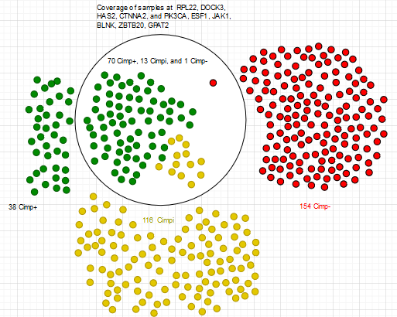

Slide 26
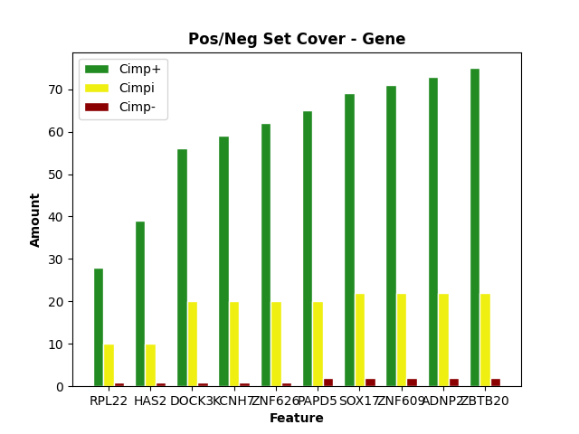
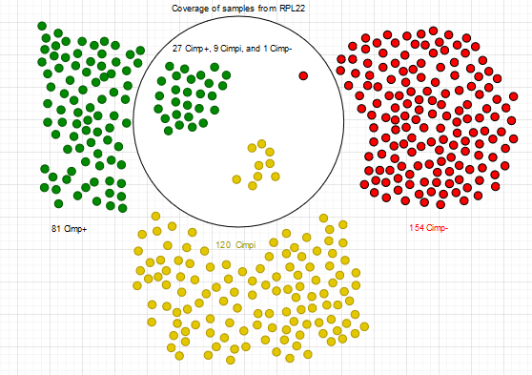
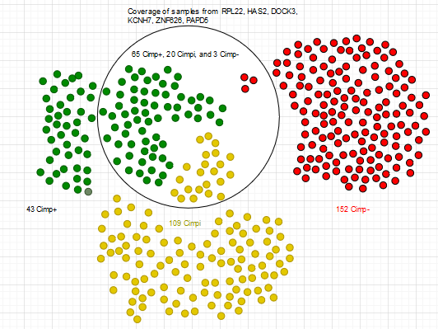
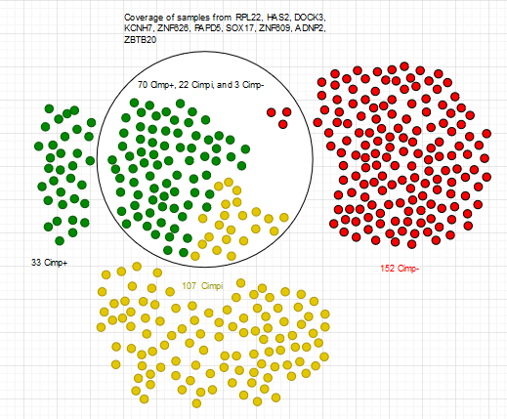

Slide 27
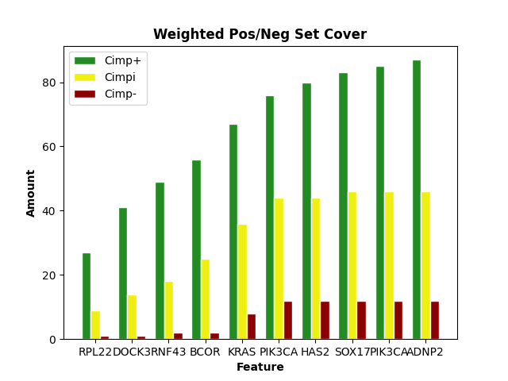
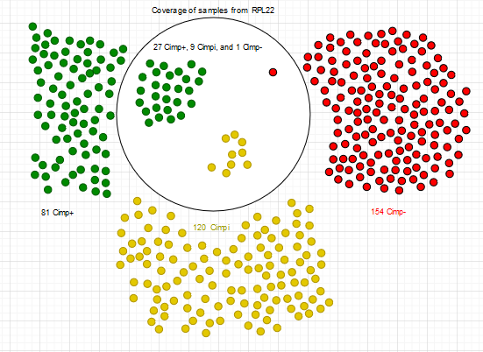
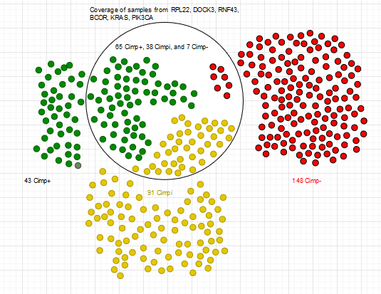
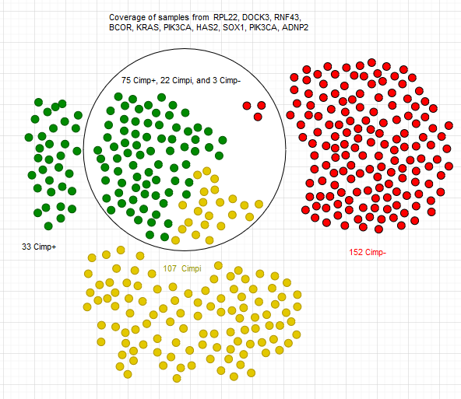

Slide 28
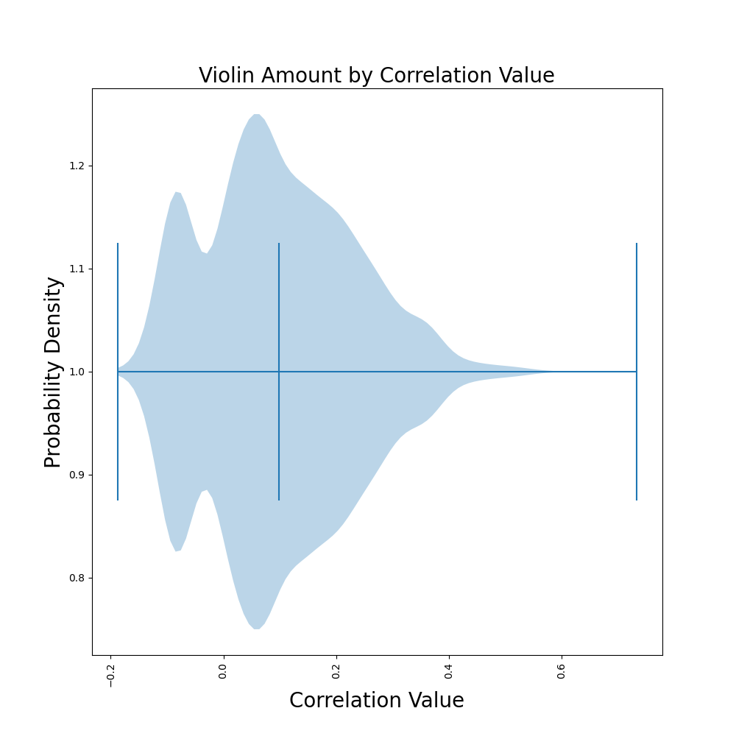
Violinplot of Correlations (only cimp+)

Slide 29
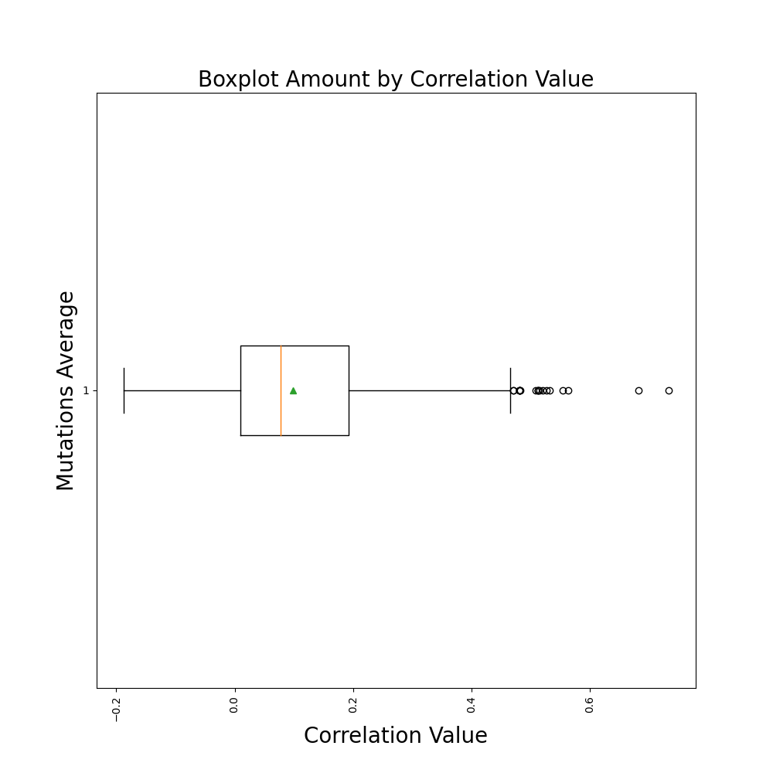
Boxplot of Correlations (only cimp+)

Slide 30
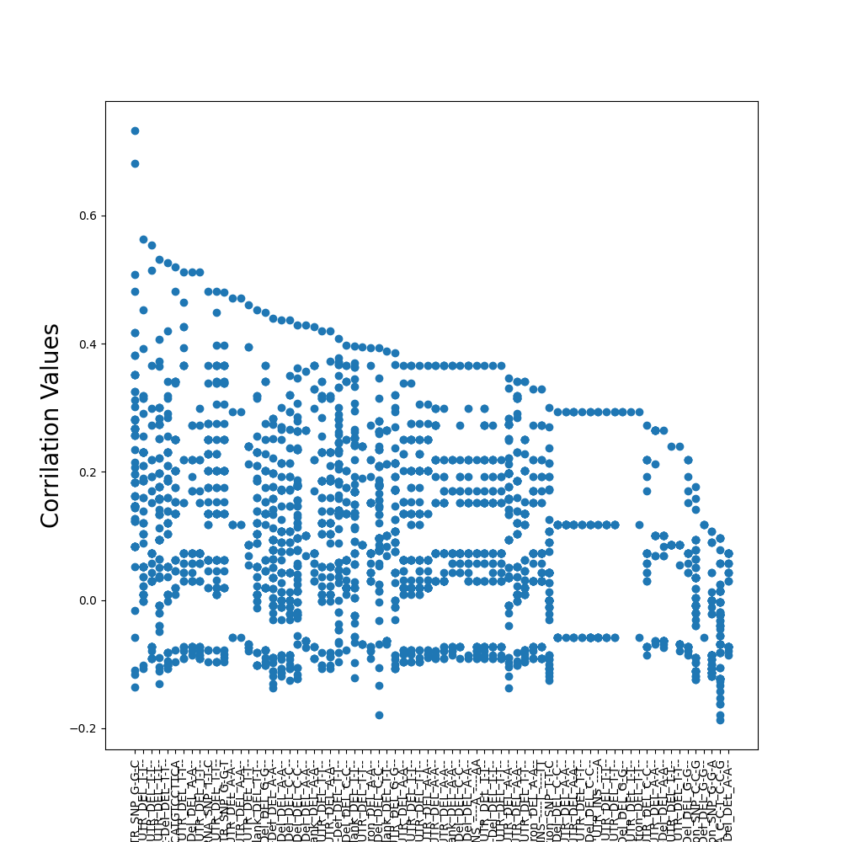
Scatterplot of Correlations (only cimp+)

Slide 31
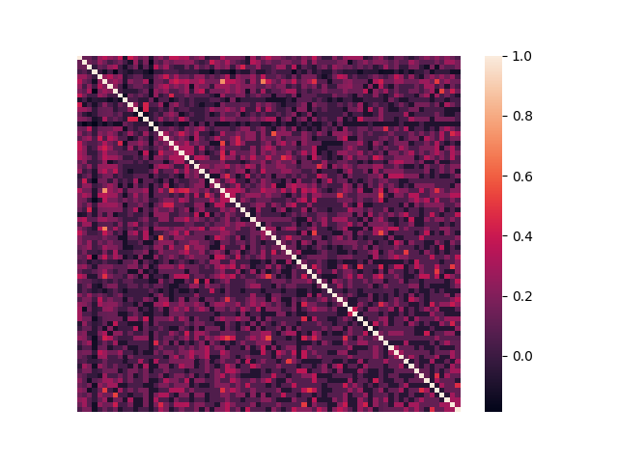
Correlation Heatmap (75 Samples / only cimp+)
Box1
Box2
Box3

Slide 32
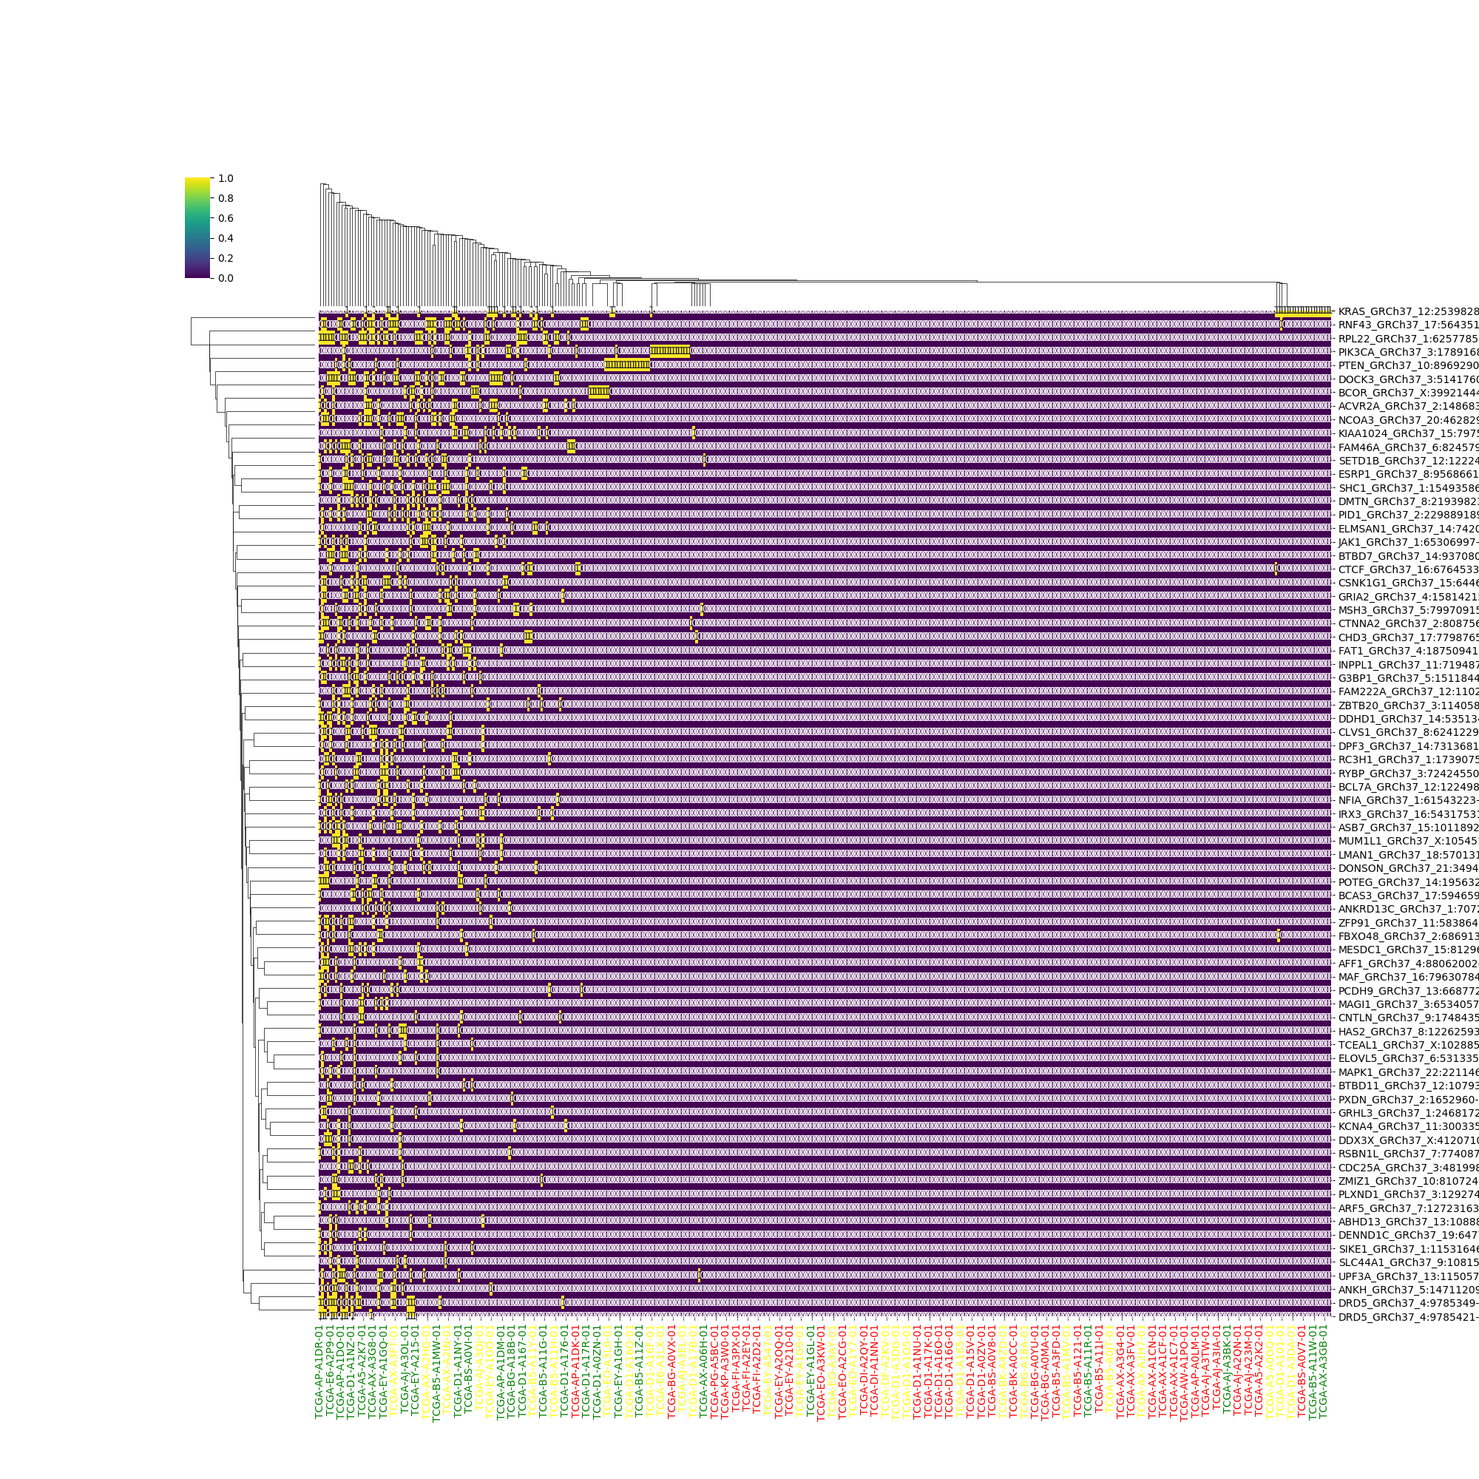
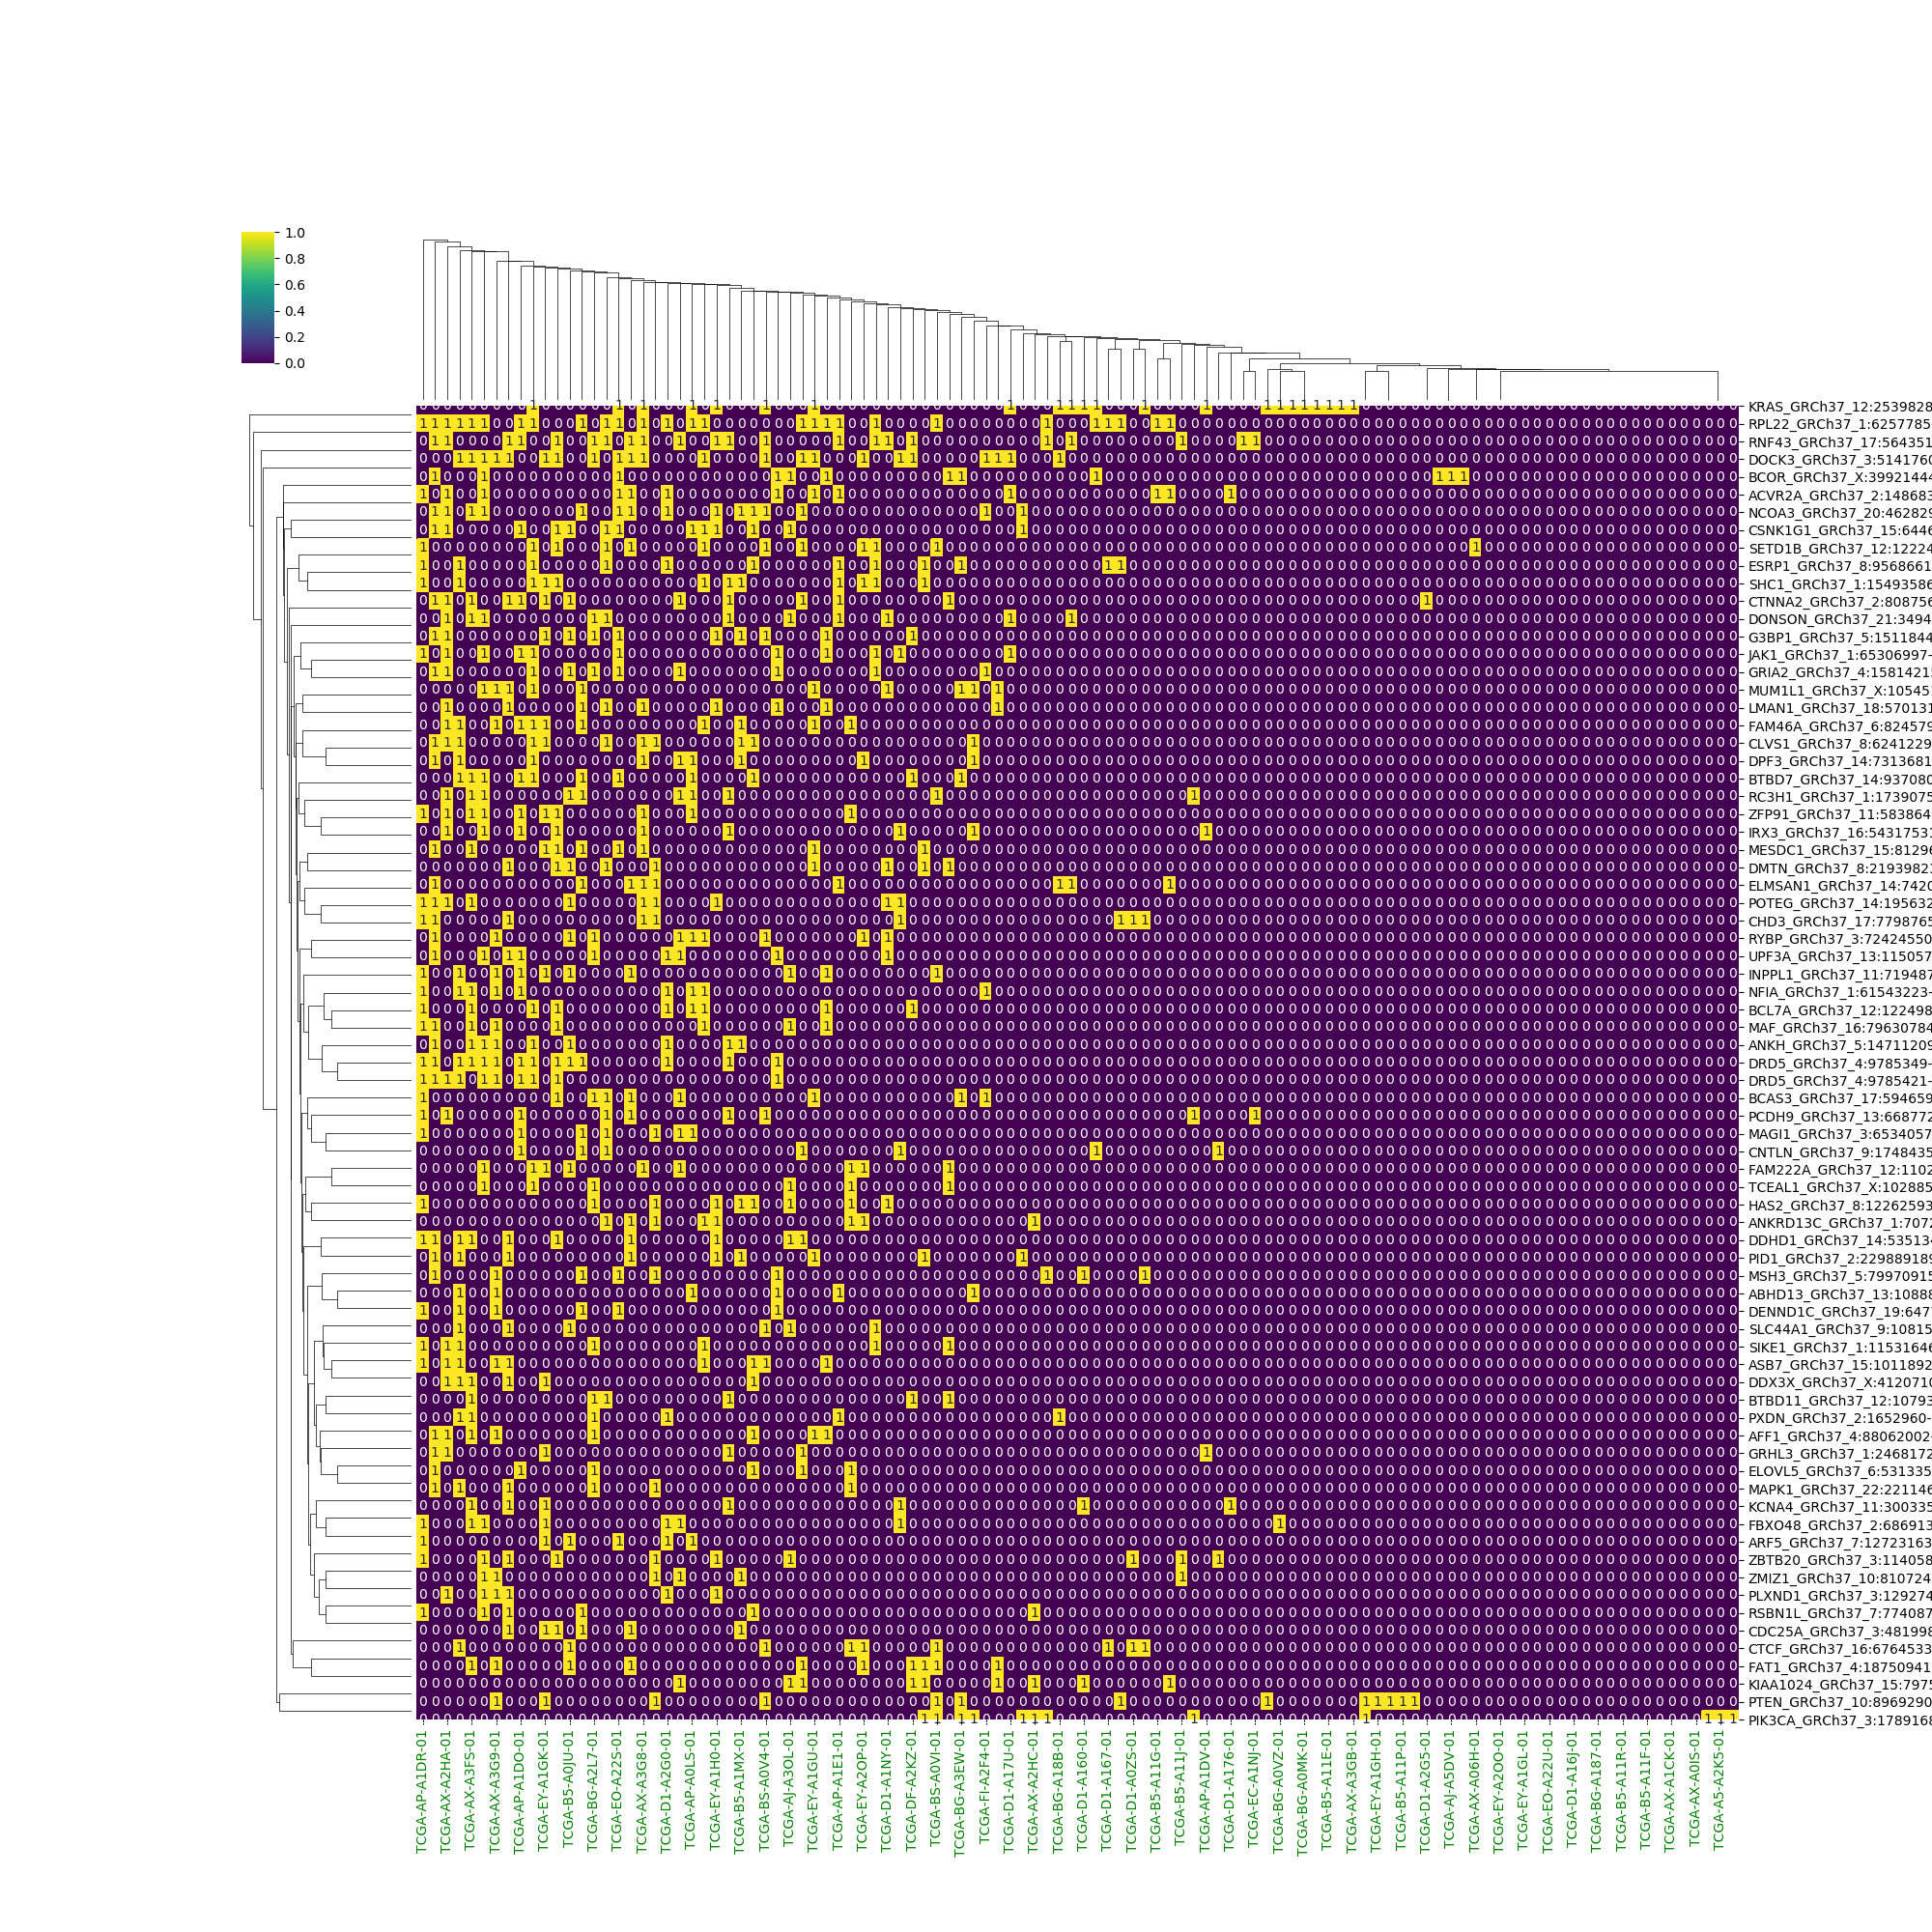
All Samples Cimp+ Samples

Slide 33
K – Means Clustering Research Question Answered
I believe this one assists in answering question numbers 1 and 2.
For 1 it may show new and interesting genes at the center of clusters. This would also help with number 2 by showing us features that are closely related.
This may help us give a better understanding of the relationships of the features.

Slide 34
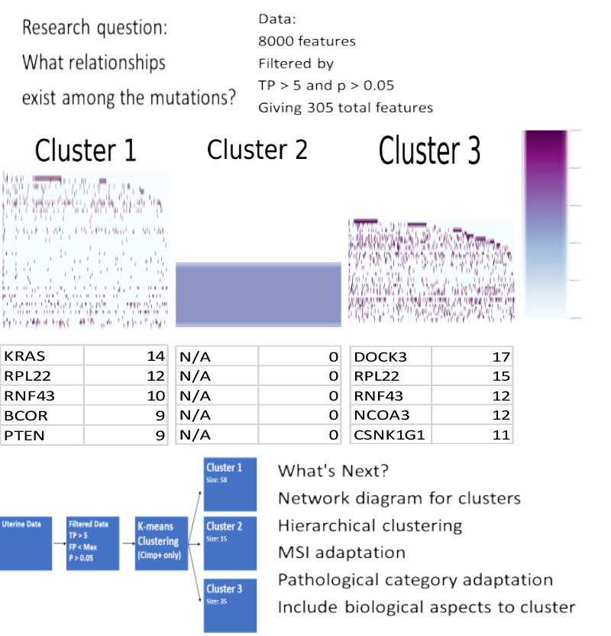

Slide 35
K – Means Clustering Method
Python Packages:
Pandas
Matplotlib
Random
Numpy
Seaborn
Parameters:
Mutfeats.csv (Cimp+)

Slide 36
Association Rule Research Question Answered
I believe this one assists in answering question number 2.
This can help by giving other ways of viewing data relationships outside of correlation value.
This may or may not provide relevant information, further analysis will show how helpful this measure will be.

Slide 37
Association Rule

Slide 38
Association Rule Method
Python Packages:
Pandas
Numpy
Seaborn
Matplotlib.pyploy
Parameters:
Mutfeats.csv (300 Features)

Slide 39
Upset Plot Research Question Answered
I believe this one assists in answering question number 2.
This helps by giving a clear graphic to show the relationship between features.
This may help give us a better understanding of the relationships of the features.

Slide 40
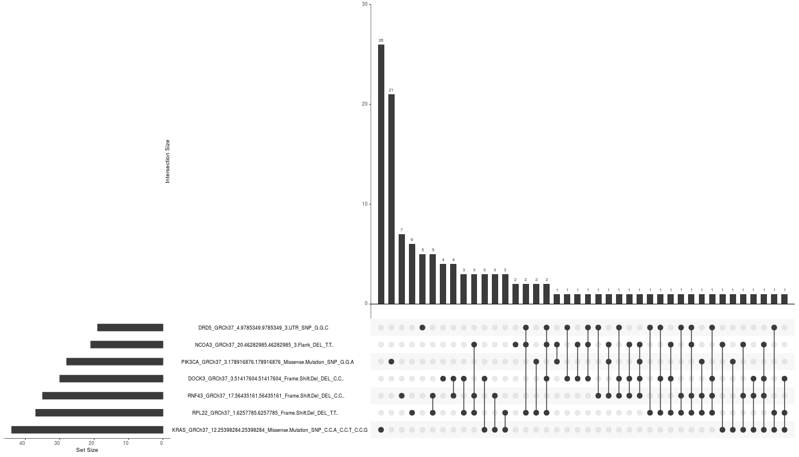
Upset Plot Made with: https://gehlenborglab.shinyapps.io/upsetr/

Slide 41
Upset Plot Method
Made with: https://gehlenborglab.shinyapps.io/upsetr/
Parameters:
Mutfeats.csv (300 features)

Slide 42
Gene Expression Data
Group 1
Δ – expr genes in Group 1
Pathway Analysis
108 Cimp+ 21K key genes
Group 2
Normalize
Δ – expr genes in Group 2
Pathway Analysis
Group 3
Δ – expr genes in Group 3
Pathway Analysis

Slide 43
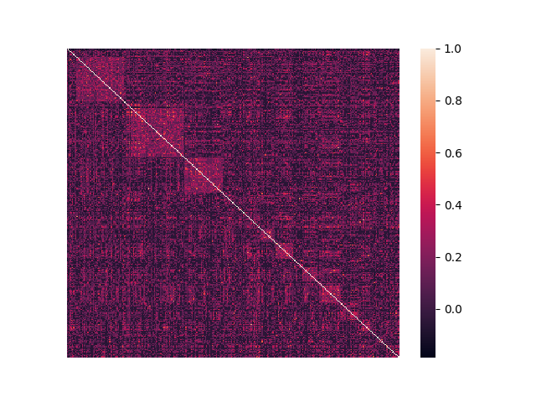
Correlation Heatmap (300 Samples / only cimp+)
Box1
Box2
Box3

Slide 44
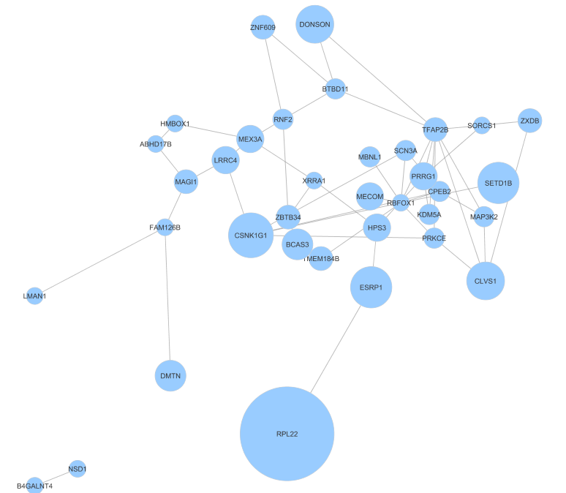
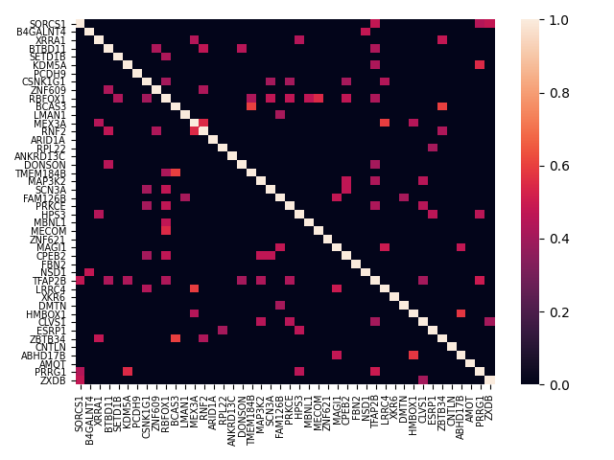
Correlation Box 1 (Correlation > 0.4)

Slide 45
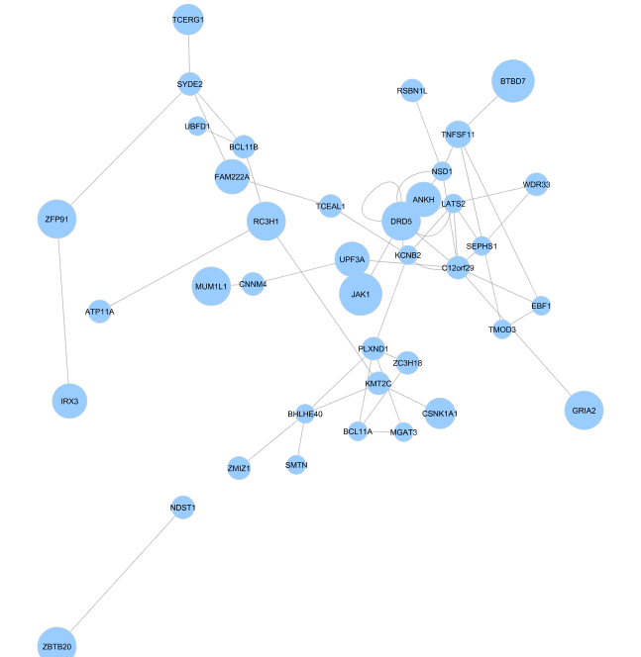
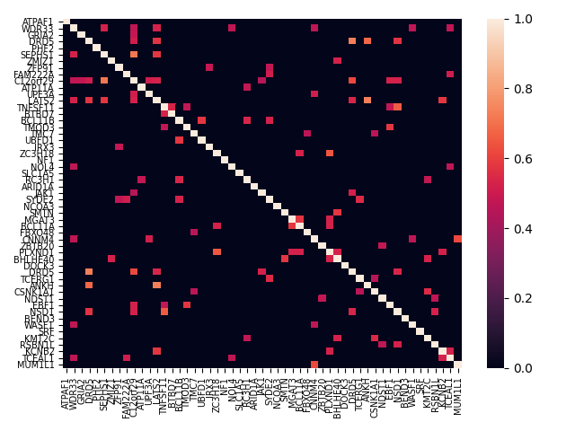
Correlation Box 2 (Correlation > 0.45)

Slide 46
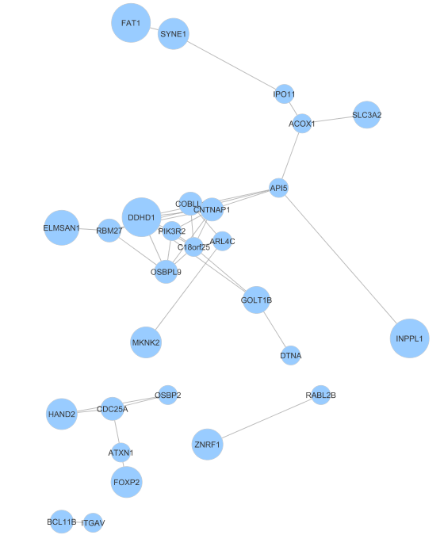
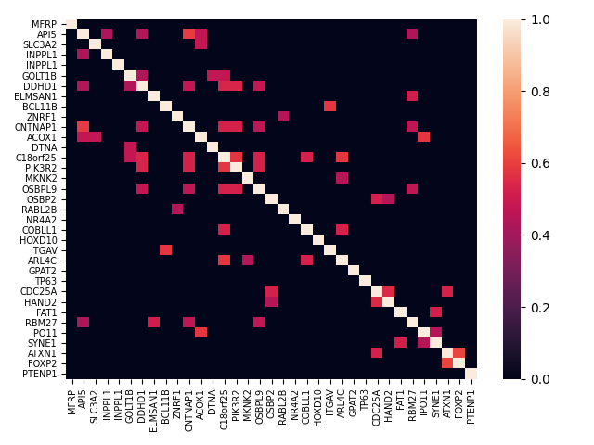
Correlation Box 3 (Correlation > 0.4)

Slide 47
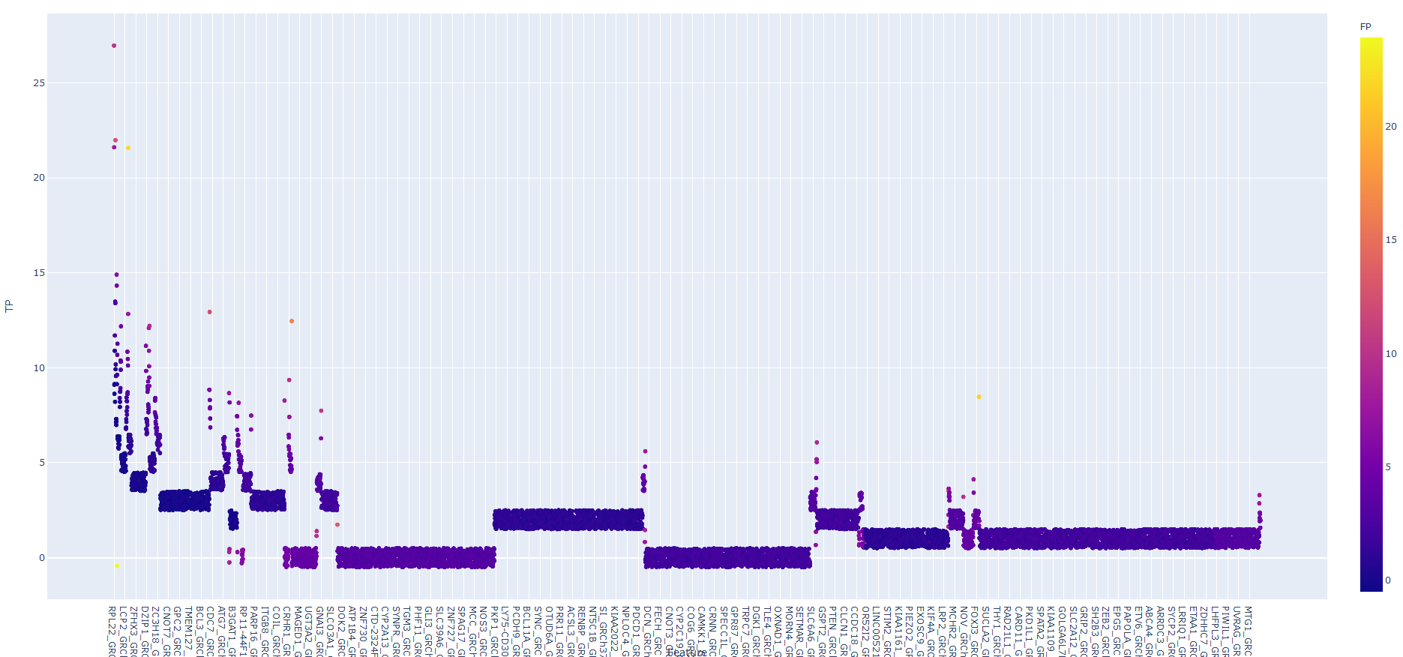
TP / Name and color = FP

Slide 48
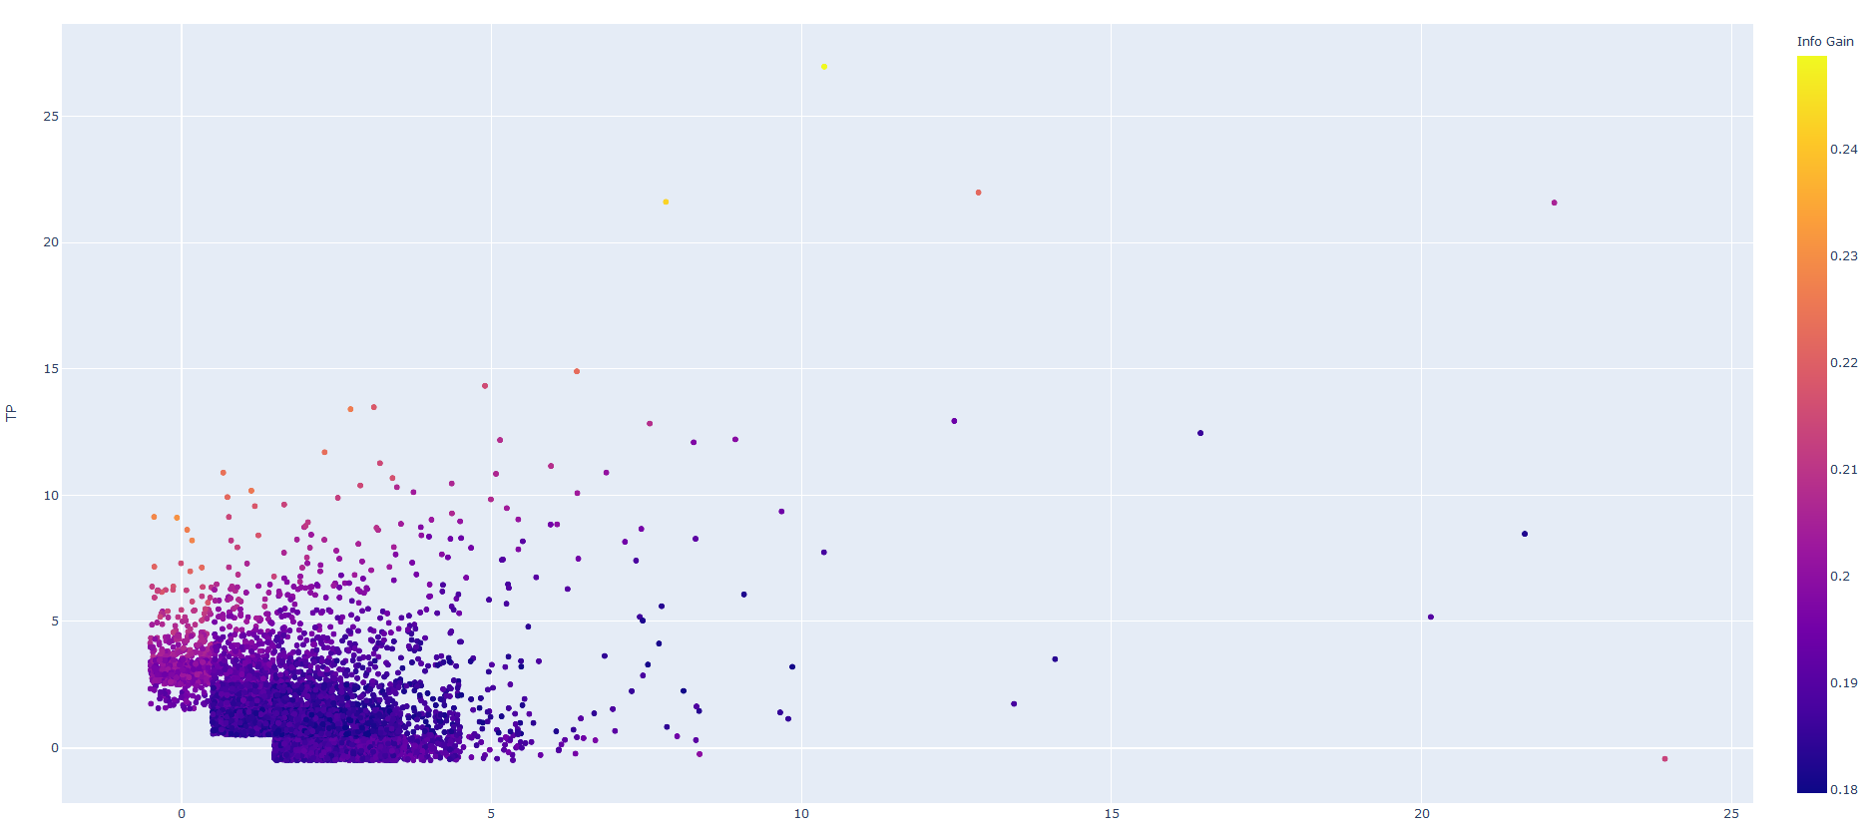
TP / FP and color = Info Gain

Slide 49
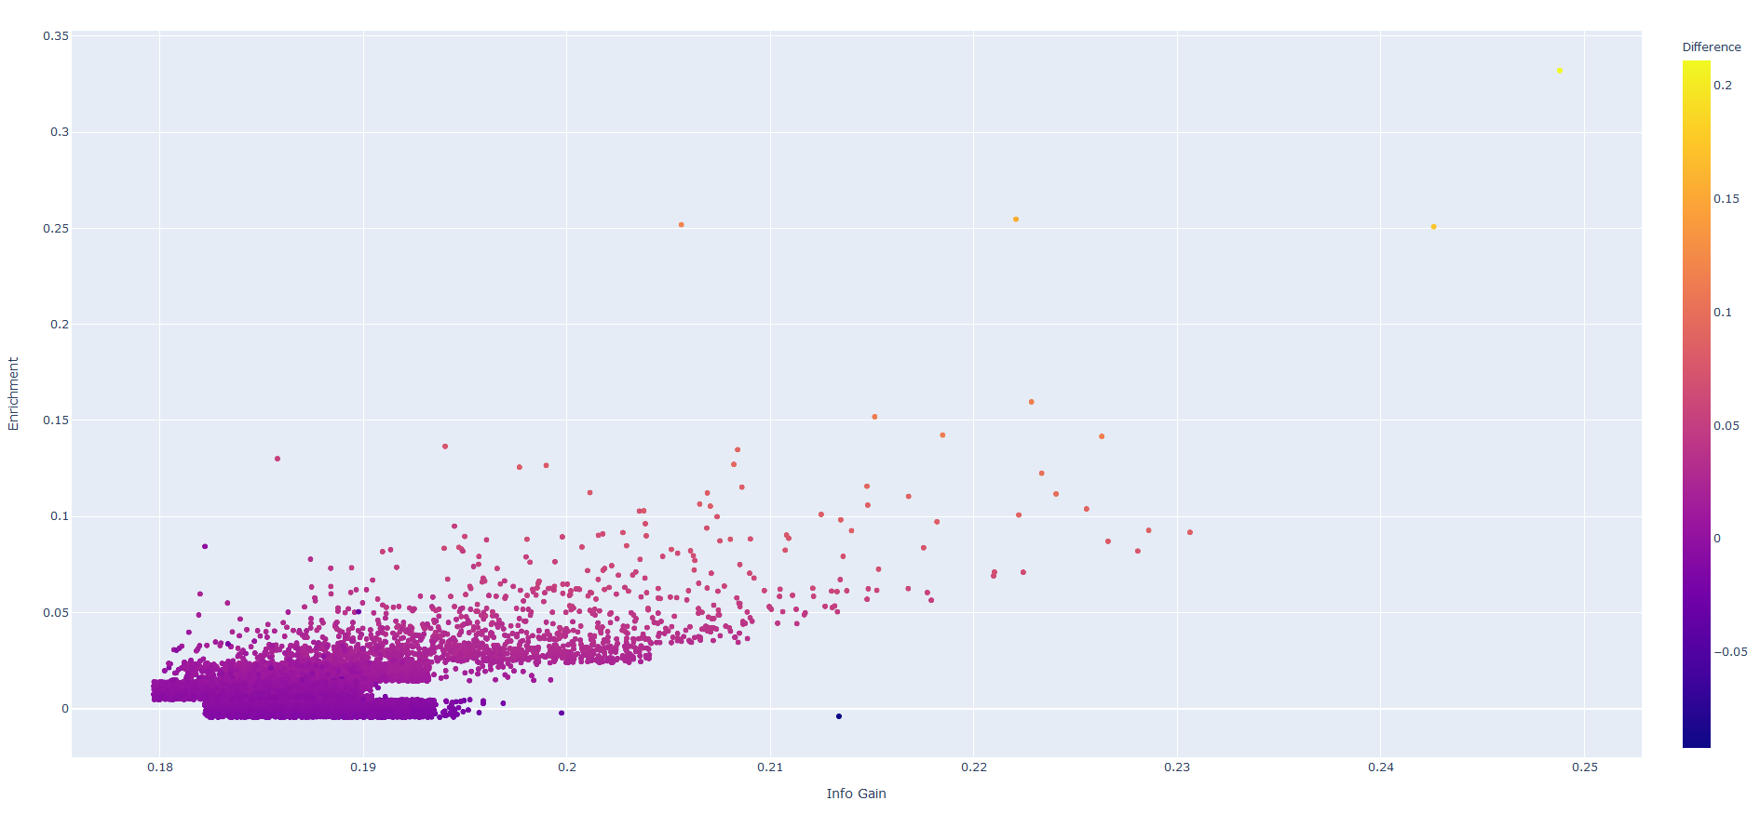
Enrichment / Info Gain and Color = Difference

Slide 50
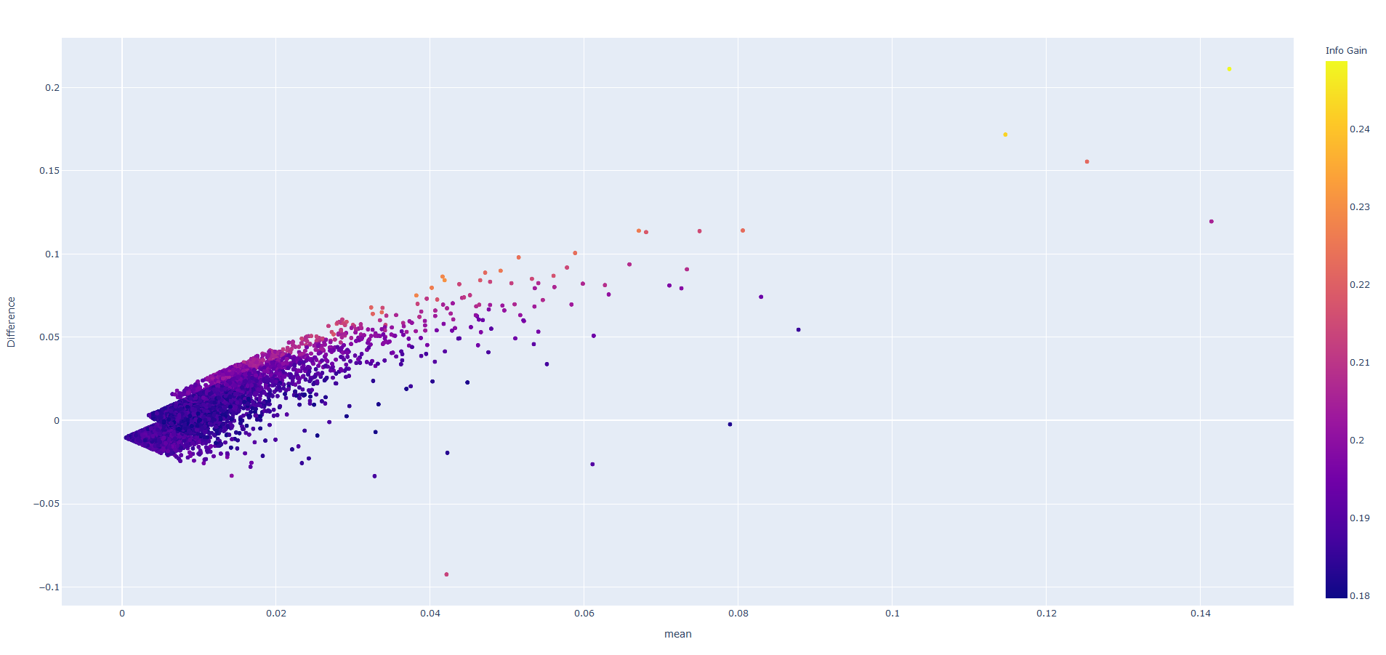
Bland-Altman Plot

Slide 51
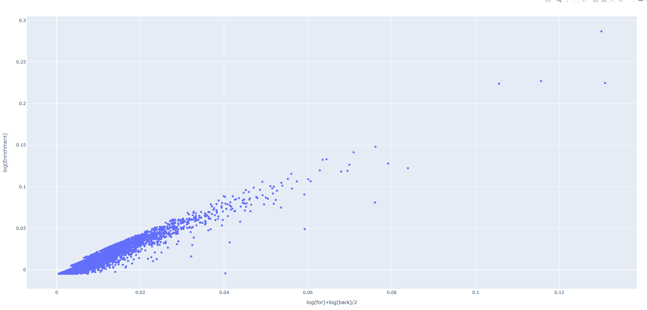
MA Plot

Slide 52
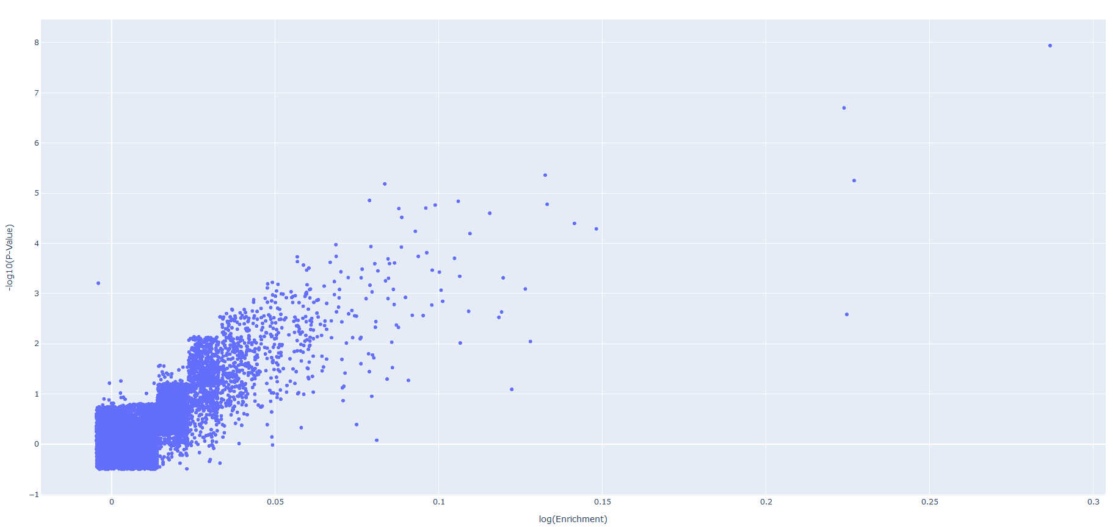
Volcano Plot

